Slide 1

Like John the Baptist
Luke 3:1-14

Slide 2

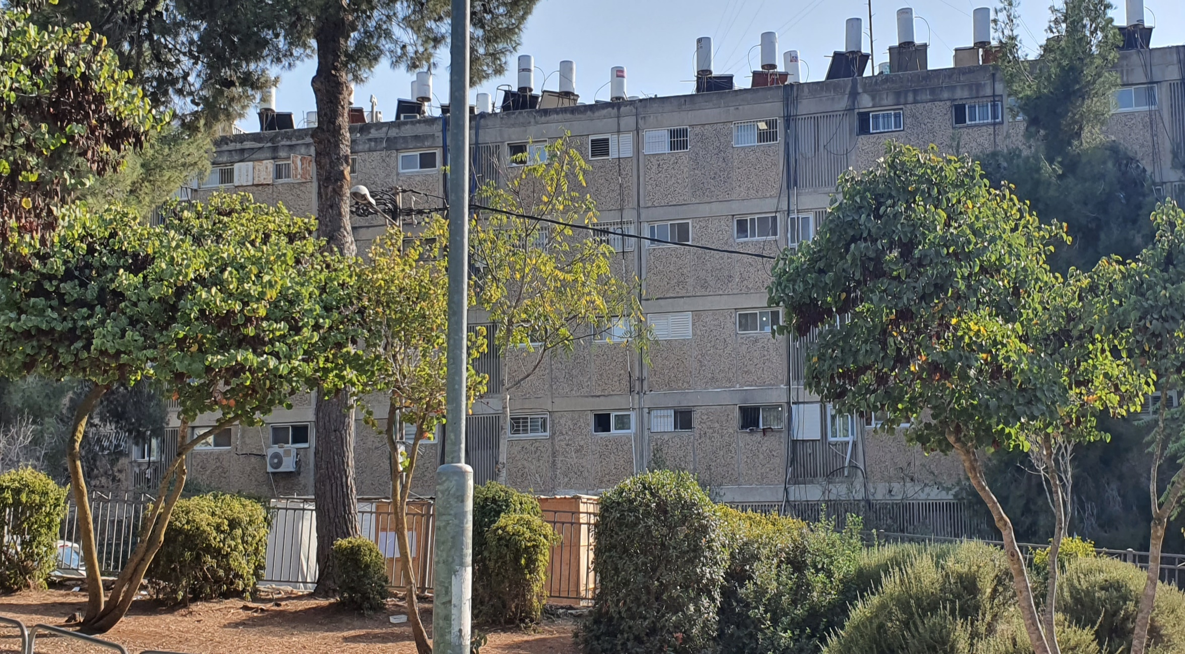
Apartment in Jerusalem

Slide 3
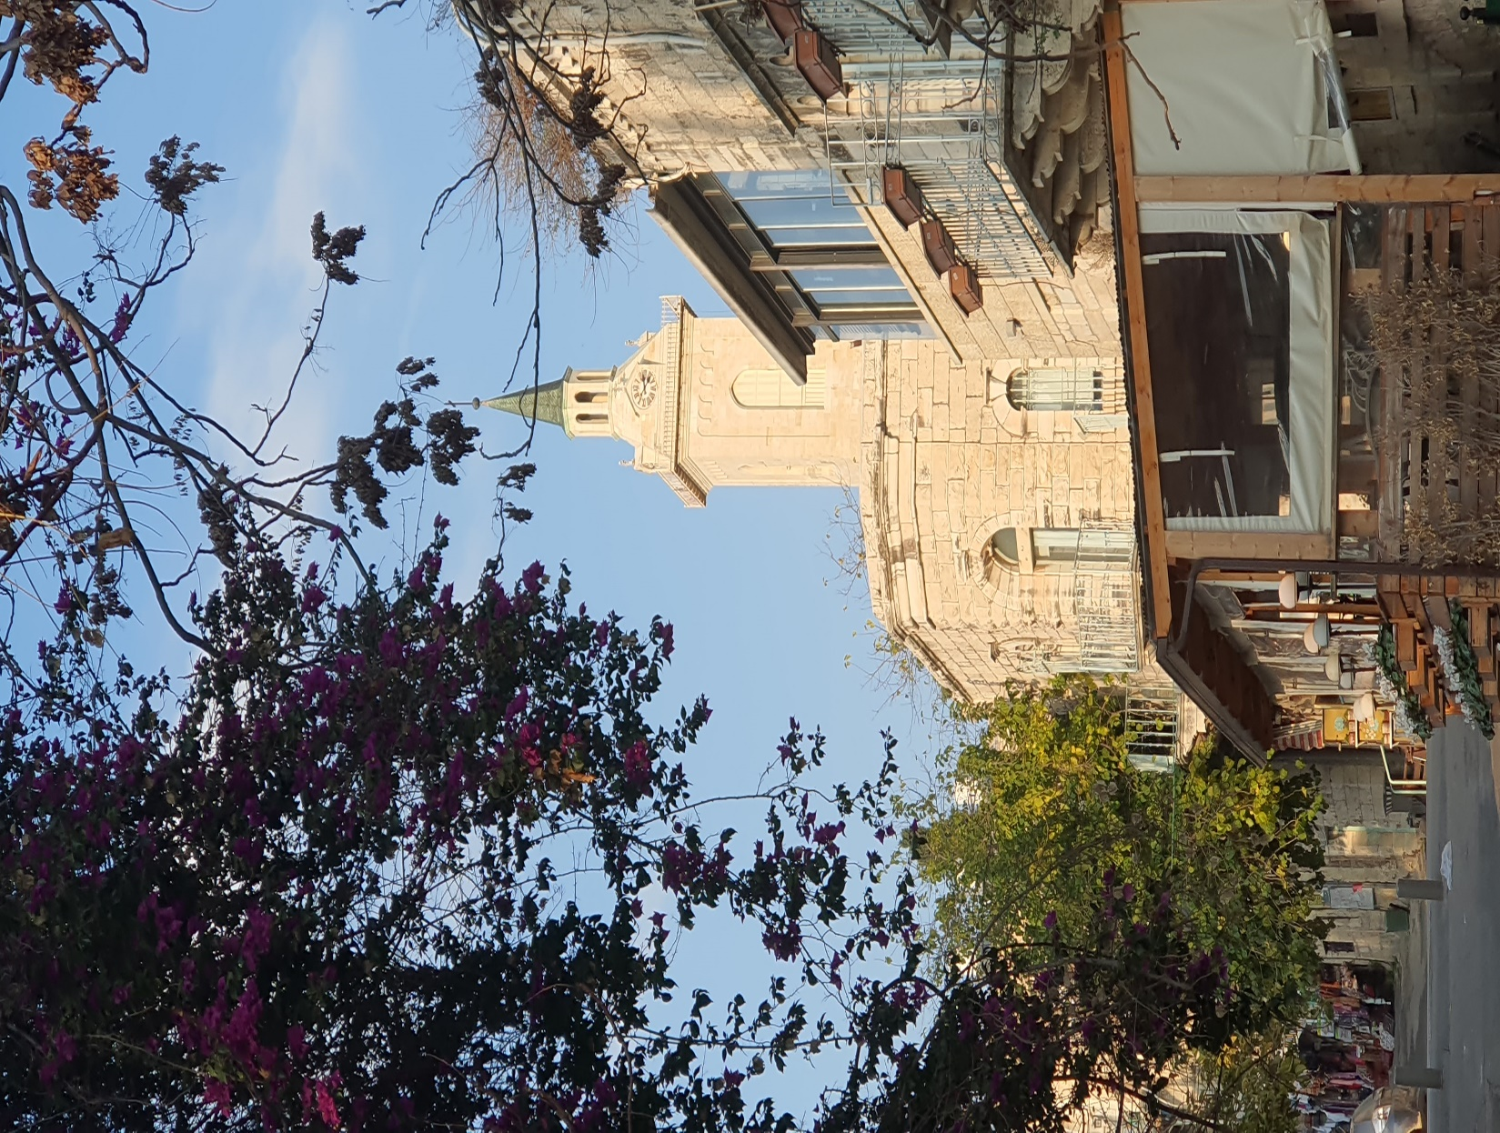
John the Baptist Memorial Church

Slide 4
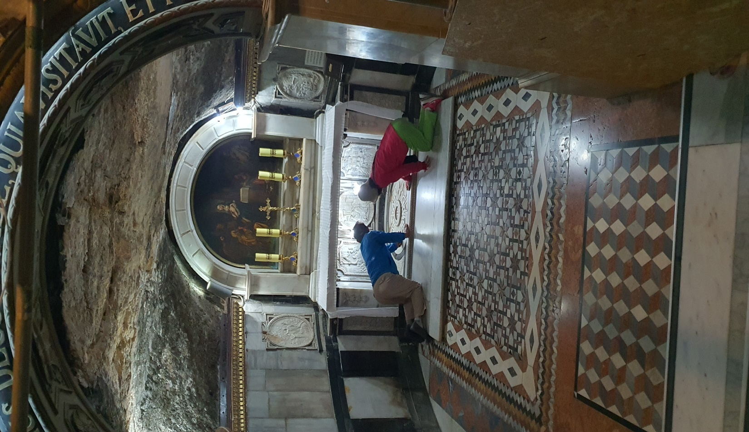
Birth place of John the Baptist

Slide 5
1. Identity

Slide 6
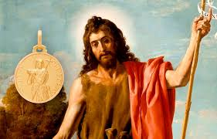
Why has John the Baptist left the Temple and went to the wilderness?
. Around before 100 B.C, King began to appoint the priests.
. Annas and Caiaphas who were the high priests in Jesus time were not Aron (Levite) lineage, but appointed by king.
. If the priest were appointed by king, religion would be secularized and temple would be controlled by political leaders.
. So John the Baptist left the temple and set out on a lonely path to seek for God in the wilderness.

Slide 7
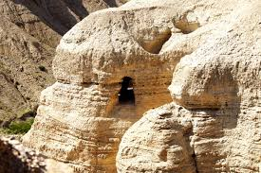
Qumran Cave

Slide 8
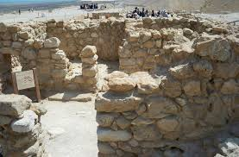
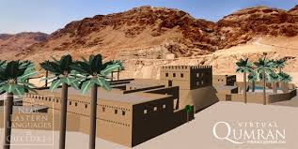
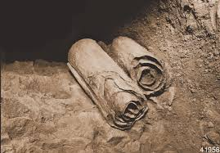
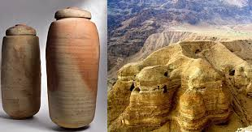
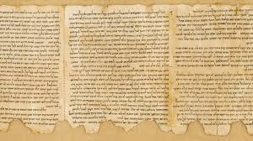
Life of Jewish People in Qumran

Slide 9

Matthew 3:4
John’s clothes were made of carmel’s hair, and he had a leather belt around his waist. His food was locusts and wild honey.

Slide 10
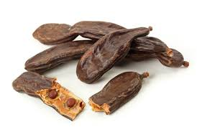
Pods

Slide 11
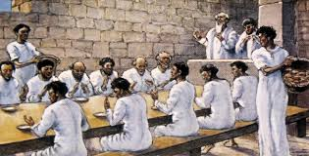
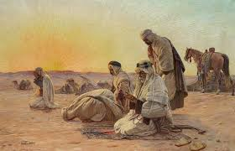
Spiritual life in the wilderness
Most of them lived as single (celibate)
Forbidden to have a private possession
Forbidden to eat meat, wine, oil
Focused on reading, writing the Scripture all the days
Every day started with early morning prayer
Simple life with white clothes
A ritual bath to follow Jewish customs
Waited on Messiah’s coming and rule

Slide 12
All power come from God, all efforts come from me.

Slide 13
Reflective Pratitioner

Slide 14


Slide 15
Meditation is looking at God (Christ) through everything
What I learned from this?

Slide 16
2. International

Slide 17
Matthew 3:1-2
In those days, John the Baptist came, preaching in the wilderness of Judea and saying, ‘Repent, for the kingdom of heaven has come near’.

Slide 18
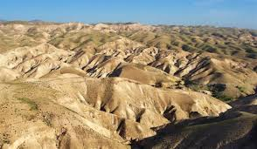
Judean Desert

Slide 19
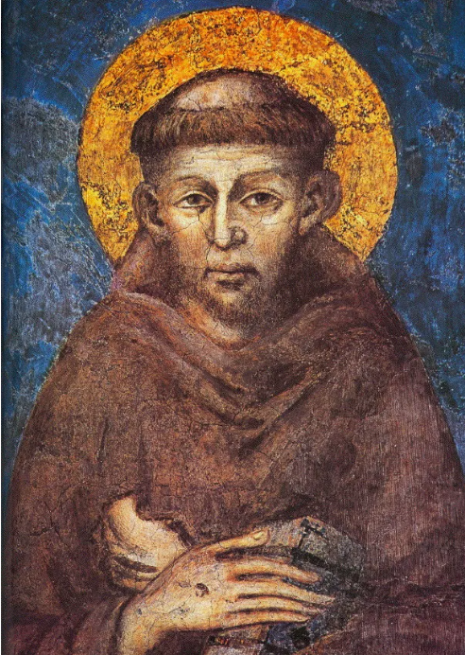
Saint Francisco

Slide 20
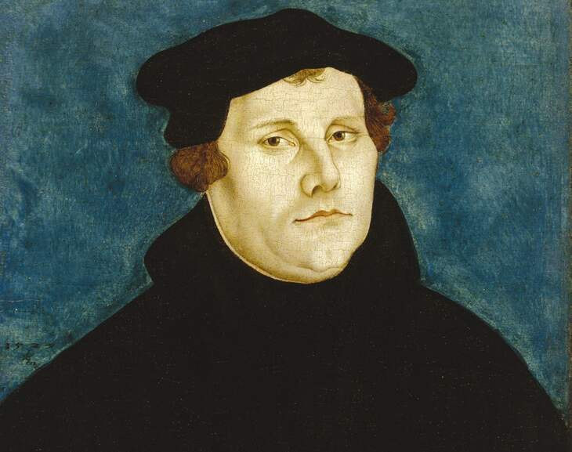
Martin Luther

Slide 21
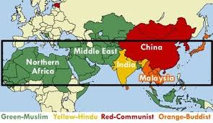
Unreached People
The Unreached People Group is a people group among which there is no indigenous community of believing Christians with adequate numbers (2%) and resources to evangelize this people group without outside assistance. (Joshua Project)

Slide 22
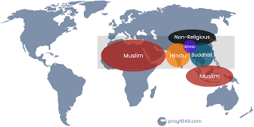
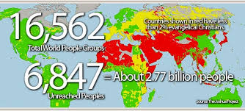

Slide 23
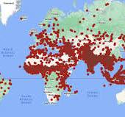
Population 1,490,666,000 | Number of Countries 58
Number of People Groups 3,749 | People Groups Unreached 972 (25.9%)
Population in Unreached 426,090,000 | Population in Unreached 28.6%

Slide 24
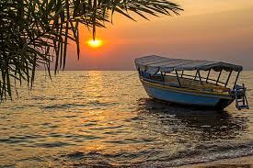
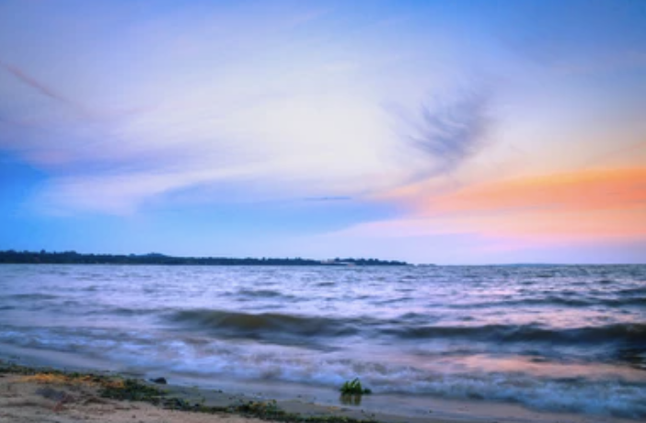
Lake Victoria

Slide 25
Let the living water flow to all over the world

Slide 26
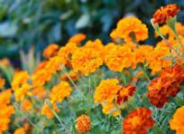




Go or Send!
Sow the seeds far away or bloom where you live now!

Slide 27
3. Interdependent

Slide 28
Don’t approve, but accept
 | Don’t approve | but accept
Rich people | Living as a rich person only by oneself richly
Tax-collectors | Collecting taxes unfairly
Soldiers | Harassing others with force

Slide 29
Three type’s Life
independent | Western individualism | Where are you belong to?
dependent | Slavery dependency
interdependent | Reciprocal dependency

Slide 30
Gal 6:2
Carry each other’s burdens. and in this way you will fulfill
the law of Christ

Slide 31
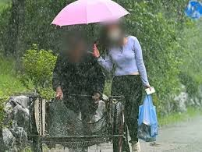
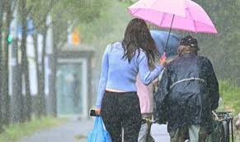
Umbrella

Slide 32
What do you learn from John the Baptist?
Identity (Spirituality) | International (World) | Interdependent (Missional Life)
Who am I before God? | To where was I sent? | Living with others interdependently

